Slide 1

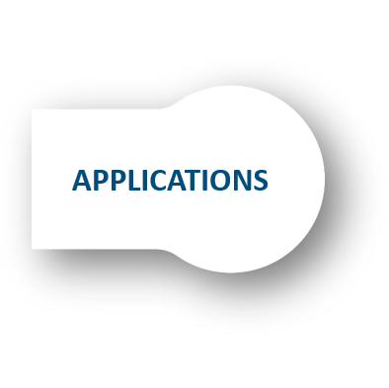


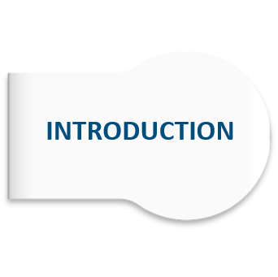
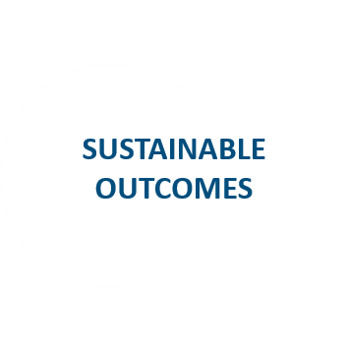

SMART GLOVE AND HAND GESTURE VOCALIZER
Rajiv Gandhi University of Knowledge Technologies - Nuzvid

Slide 2

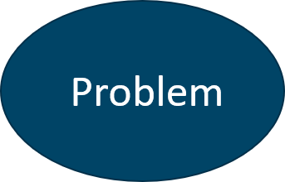
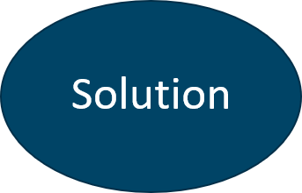
Introduction

Slide 3
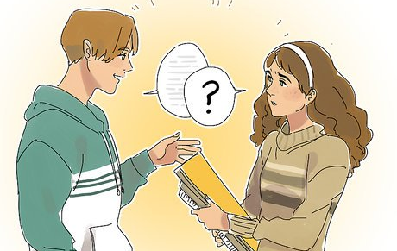
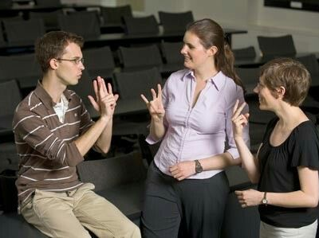
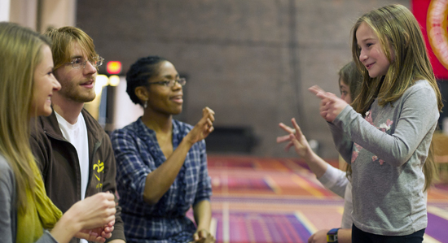
Problem
According WHO research the total partial paralyzed persons across the world 9.1 billion they all are deaf & dumb and 5% of world population.
Across the India 126 million people are partial paralyzed.
And the country only has about 700 schools which teaches sign language for deaf & dumb peoples.
Deaf and Dumb faces difficulty in communication with normal person. Because of this, a person who lacks in hearing and speaking ability is not able to stand in race with normal person.

Slide 4
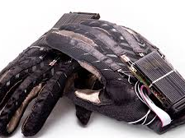
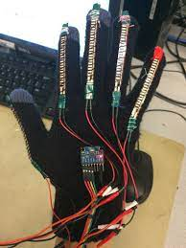
Solution
To overcome these constraints we aim to design an efficient Smart Glove and Hand Gesture Vocalizer system by using DE10 lite Board which is FPGA and Bluetooth Module.

Slide 5

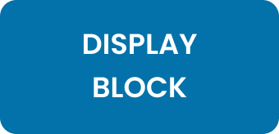
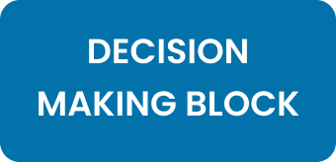
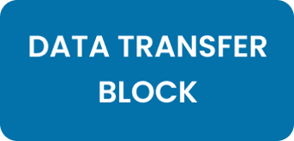
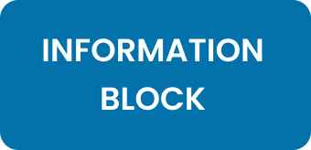
Design Introduction

Slide 6
Information Block
Collecting the data from the Sensors.
Transferring the collected data to DE10 lite FPGA Board.

Slide 7
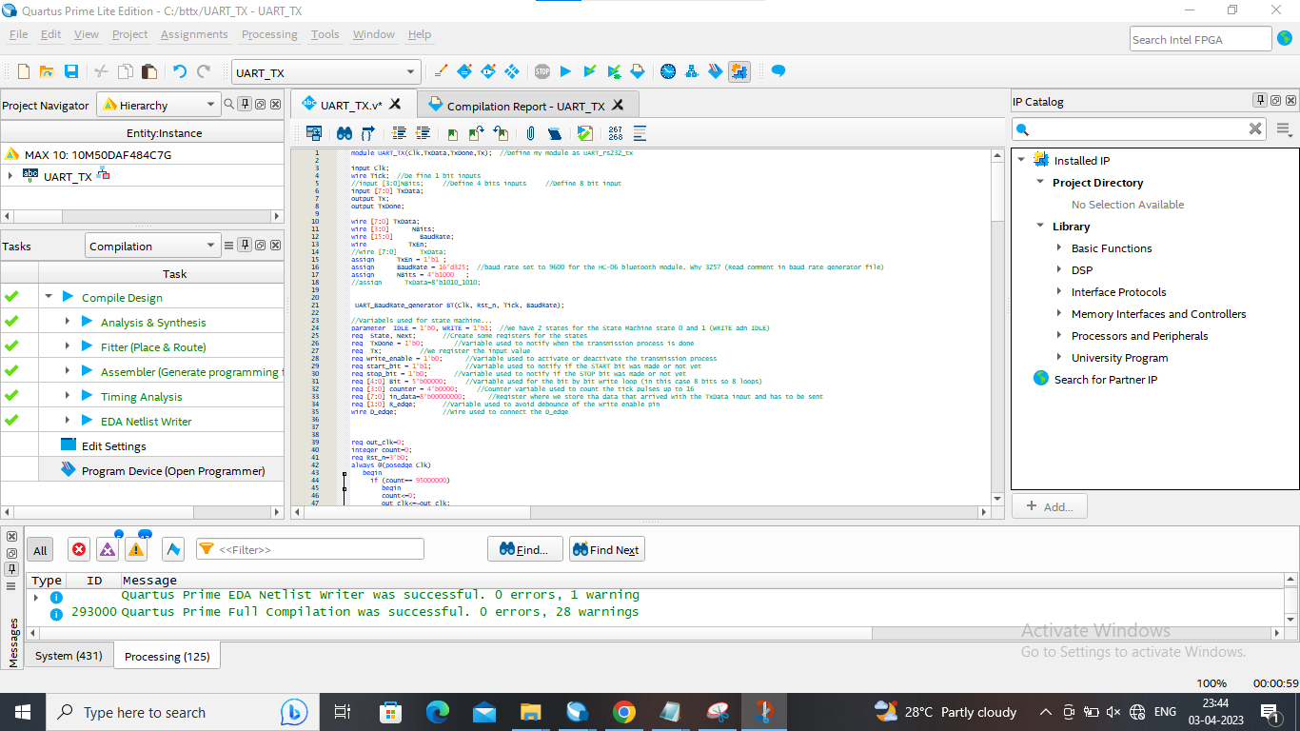
Quartus Prime

Slide 8
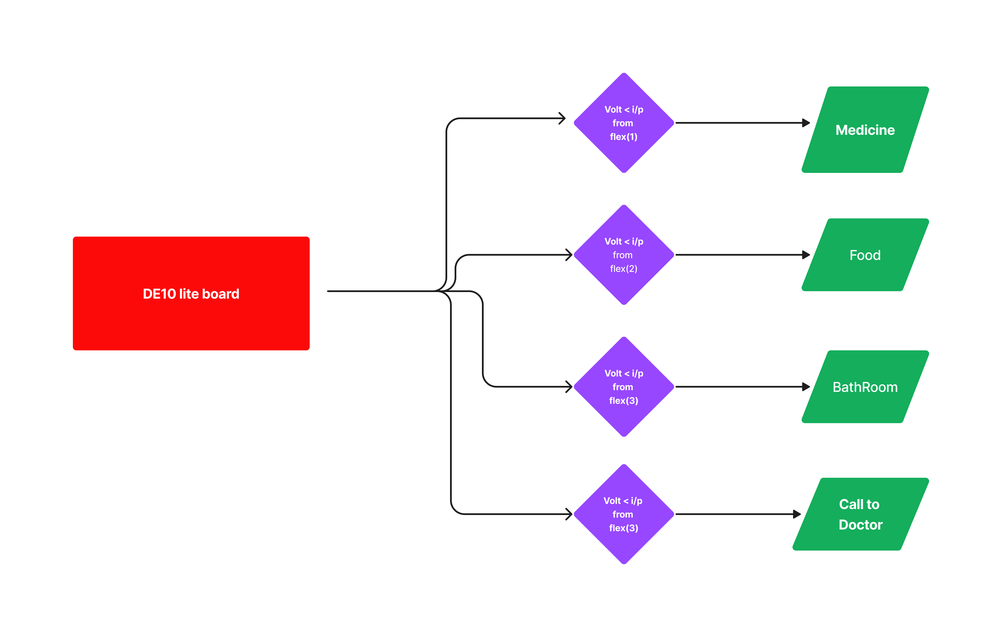
Decision Making Block

Slide 9
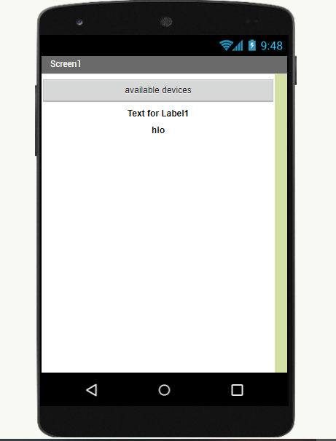
Mobile App

Slide 10
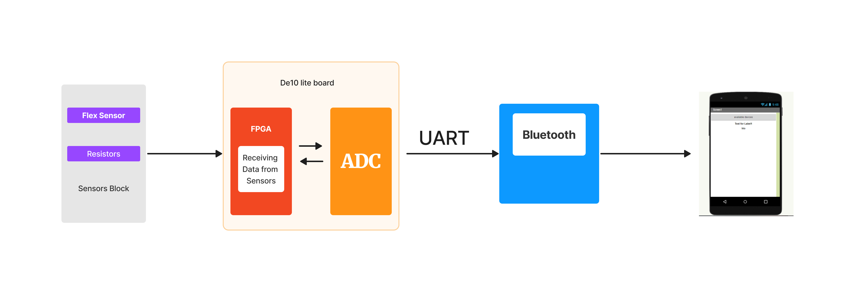
Architecture

Slide 11
Sustainable Outcomes
Our design provides secondary communication to deaf and dumb people .
Help people with disabilities, such as those who have lost the use of their hands

Slide 12
Applications
Communication Aid: The device can be used by people with speech or hearing disabilities to communicate with others using hand gesture.
Medical rehabilitation: The device can be used in medical rehabilitation to help patients regain hand dexterity and mobility after an injury or surgery.

Slide 13
Target Users
The target users for a smart glove hand gesture vocalizer could include individuals who have difficulty speaking.
Such as those with speech impairments, physical disabilities
And deaf and dumb persons.

Slide 14
Future
Advancements
Miniaturization: With advances in miniaturization technology, it may be possible to create a smaller and more discreet smart glove that is easier to wear and use." Wireless connectivity: The smart glove could be made wireless, allowing for greater mobility and flexibility for users.
Improved accuracy: Flex sensors can detect the degree of bending of each finger, which could allow for more precise recognition of hand gestures and, thus, better accuracy in vocalizing the intended message.
Based on the results after checking, we can develop a system to partial paralyzed peoples.

Slide 15
Thank All The End

